Slide 1
aBC cALL volume trend analysis
By: Mohak Bidaye

Slide 2
Project Description
This project focuses on analyzing inbound customer support call data over a 23-day period to gain insights into customer experience (CX) trends. The dataset includes key metrics such as agent details, queue time, call duration, time of call, and call status (answered, abandoned, or transferred).
Inbound customer support is a key function, focusing on handling calls from existing and prospective customers to attract, engage, and retain them. This project aims to provide data-driven insights that can optimize the efficiency and effectiveness of inbound call operations.
My objective is to leverage data analytics to identify patterns in call volume, agent performance, and customer wait times to enhance CX strategies and improve customer satisfaction.

Slide 3
APPROACH
Firstly I downloaded the dataset
Gained an understanding of the data
Cleaned and handled missing data
Performed the tasks and found insights from the clean data
Data visualisation was done through graphs and charts

Slide 4
TECH STACK
Microsoft Excel
Microsoft Power Point

Slide 5
Data Cleaning
The dataset provided contains 13 columns and 117989 rows.
The Wrapped_By column contains blank cells.
Call_Status and Wrapped_By are adjacent columns.
Agent_Name and Agent_ID are also adjacent.
Calls marked as "Abandon“ in the Call_Status have #N/A for Agent_Name and Agent_ID, meaning no agent handled them.
Calls marked as "Answered" always have an assigned Agent_Name and Agent_ID.
If Call_Status = "Abandon", fill the blank Wrapped_By values with "Call Abandoned".
If Call_Status = "Answered", fill the blank Wrapped_By values using mode imputation with "Agent" (since an agent must have ended the call)

Slide 6
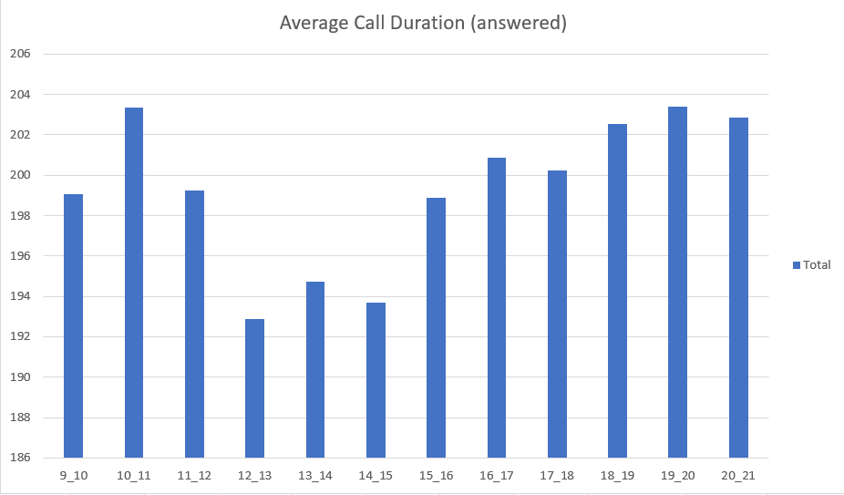
Insights
Task 1: What is the average duration of calls for each time bucket?
The maximum average call duration is of time bucket 7pm-8pm.
The least average call duration is observed during 12pm-1pm.

Slide 7
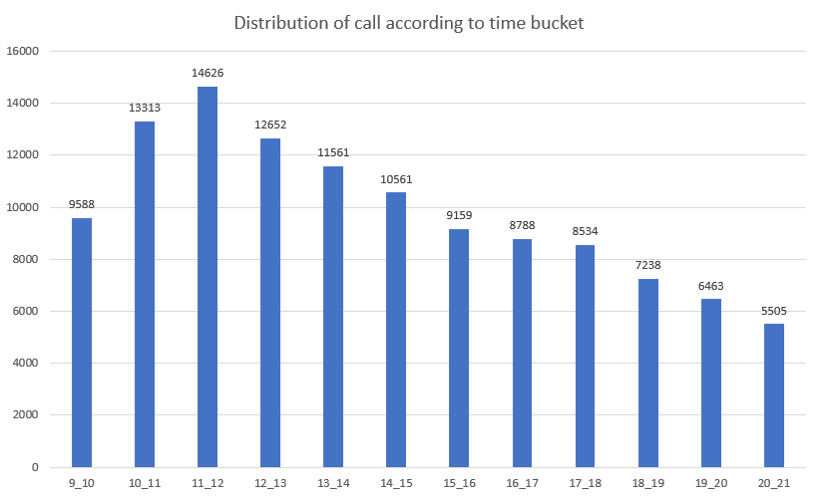
Task 2: Visualize the total number of calls received. This should be represented as a graph or chart showing the number of calls against time. Time should be represented in buckets.
The highest number of calls (14,626) occurs between 11am-12pm, indicating this is the busiest hour.
After 12pm, call volume starts decreasing, with a steady decline throughout the afternoon and evening.
The lowest number of calls (5,505) is recorded between 8pm-9pm suggesting reduced activity in the late evening.
There is a sharp increase in calls from 9am-11am indicating a busy start to the day, possibly due to business-related activities.

Slide 8

Task 3: What is the minimum number of agents required in each time bucket to reduce the abandon rate to 10%?
Procedure:
A Pivot Table was created to analyze call trends over 23 days, identify peak hours, and understand abandonment patterns.
Using the AVERAGE() function, the total number of incoming calls per day across all statuses was found to be 5,130 calls/day.
To estimate time needed to answer 90% of calls we multiply total calls per day(5130) into average time taken to answer a call (199 secs) into the target answer rate (90% i.e. 0.9) and divide this by 3600 to convert to hours.
5130 * 199 * 0.9$÷$3600 = 255 hours

Slide 9

To calculate the number of agents required we divide the total time needed to answer calls(255 hours) by the total working hours per agent (4.5 hours)
255 $÷$ 4.5 = 57 agents
To find the minimum agents required per time bucket, the total agents (57) were distributed based on the percentage of total call seconds in each time bucket.
Each time bucket's percentage of total call seconds was multiplied by 57 (total agents required) to determine the minimum agents needed for that hour.
Time buckets with higher call volumes receive more agents and the time buckets with lower call volume receive fewer agents.
This ensures efficient staffing while minimizing idle time and customer wait time.

Slide 10
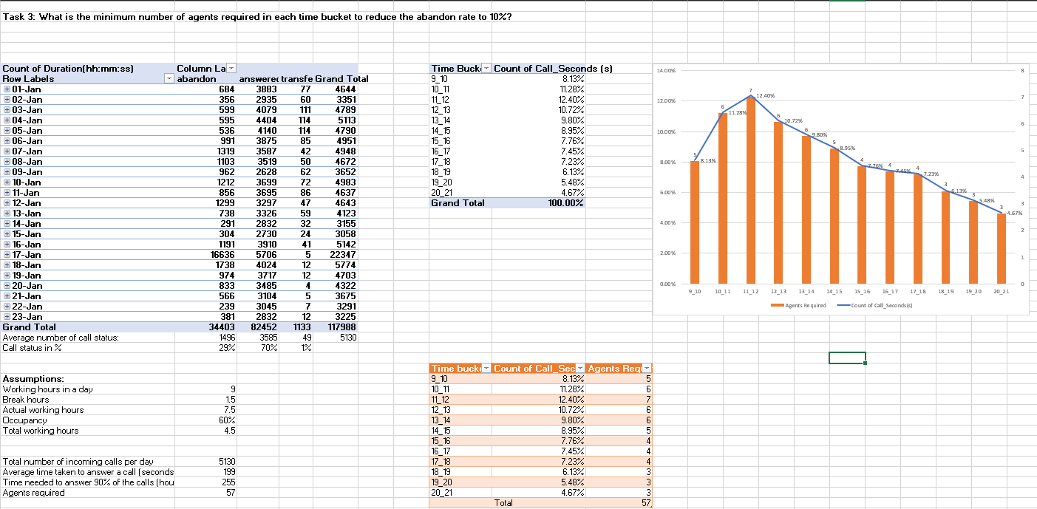
The 57 agents required are strategically distributed across time buckets based on call volume trends to ensure 90% of calls are answered, significantly reducing the abandon rate from 30% to 10%.
This analysis enables efficient workforce allocation, ensuring better customer experience and lower wait times.

Slide 11
Task 4: Propose a manpower plan for each time bucket throughout the day, keeping the maximum abandon rate at 10%
Procedure:
We know that the average total calls are 5130. 30% calls are made at night after 9 pm to 9 am.
So, average calls made at night is 5130 * 0.3 which is 1539.
We calculate total hours required to handle night calls by multiplying average calls made at night (1539) into average time taken to answer a call (199) into the target answer rate (90% i.e. 0.9) and divide this by 3600 to convert it into hours.
1539*199*0.9÷3600 = 77 hours

Slide 12
By using the assumptions,
To determine the number of agents required we divide the total hours required to handle night calls (77 hours) by the effective working hours per agent(7.5 * 60% = 4.5 hours).
77 ÷ 4.5 = 17 agents
Now, to allocate agents across each time bucket we use the distribution of calls across different time buckets which is provided to us.
Each time bucket has a call distribution ratio.
The ratio is calculated as calls in time bucket divided by total night calls (30)
The ratio helps allocate agents proportionally based on the call distribution for each time bucket.
Next, the number of agents for each time bucket is obtained by multiplying this ratio with total agents required (17)
The total number of agents needed is found to be between 17 and 19.

Slide 13
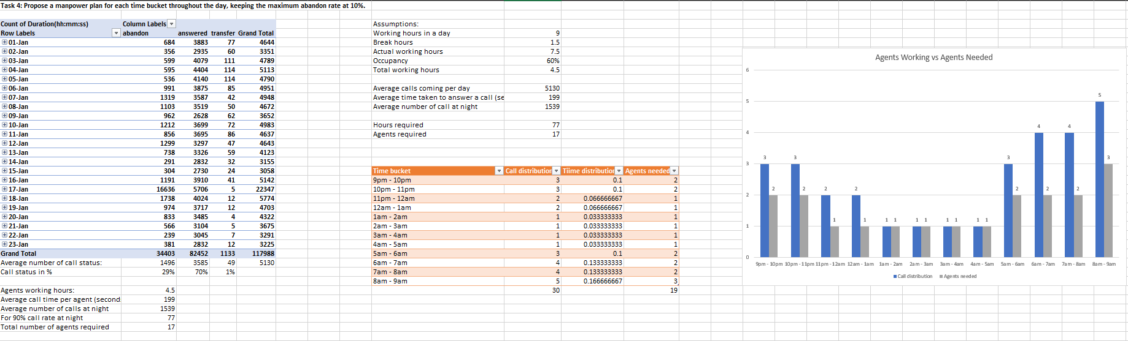
The chart represents the required number of agents per hour during the night shift.
More agents are needed around 9pm-10pm and 8am-9am, indicating higher call volumes at these hours.
Fewer agents are required between 12am-5am suggesting lower call volumes.
This ensures enough agents are allocated to maintain a maximum 10% abandon rate.

Slide 14
CONCLUSION
This project highlighted the importance of customer experience (CX) in the success of a business, particularly in inbound customer support. By analyzing 23 days of call data, I gained insights into agent performance, customer wait times, and call outcomes. I learned how factors like queue times, call durations, and call status (answered, abandoned, or transferred) impact overall customer satisfaction.
Additionally, this project reinforced my statistical and mathematical skills, which are essential for a data analyst. It also provided a deeper understanding of workforce planning and the strategic decisions involved in optimizing agent allocation to enhance operational efficiency. Most importantly, I now have a clearer perspective on how businesses manage customer support behind the scenes to improve service quality and efficiency.

Slide 15
LINK
Excel link:
https://docs.google.com/spreadsheets/d/1xHuclP8lVUIHFW6Gb7uoWEwvhVMU6aJC/edit?usp=drive_link&ouid=109524556463170667809&rtpof=true&sd=true

